Slide 1
Company Orientations… The New Marketing Realities Marketing & Customer Value Corporate & Business Planning
MG1002 MARKETING MANAGEMENT | Spring 2025
PART - I:
Understanding Marketing Management
CHAPTER 2
Dr. Syed Shujaat Ali Shah shujaatalishah.visiting2025@lhr.nu.edu.pk

Slide 2
Marketing & Customer Value The Central Role of Strategic Planning
Levels in Strategic Planning [Typical]
Corporate Level
Division Level
Business Unit Level
Product Level
Marketing Plan is central instrument for directing and coordinating marketing effort
Strategic Marketing Plan lays out target markets & value proposition
Tactical Marketing Plan lays out specifics of marketing activities

Slide 3
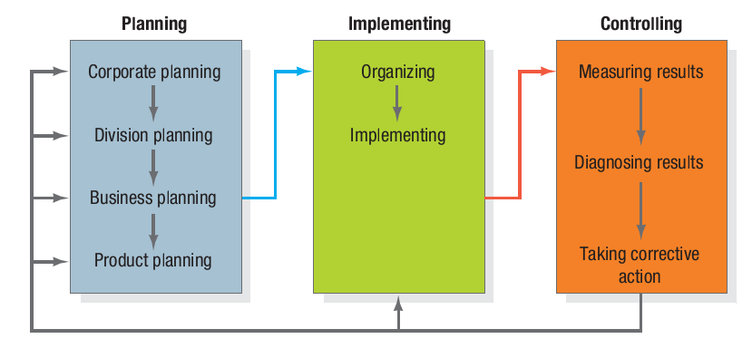
Marketing & Customer Value The Central Role of Strategic Planning

Slide 4
Corporate & Division Strategic Planning Different Planning Activities
Four Planning Activities (at Corporate & Division level)
Defining the Corporate Mission
Establishing Strategic Business Units
Assigning Resources to each SBU
Assessing Growth Opportunities

Slide 5
Corporate & Division Strategic Planning 1. Defining the Corporate Mission
Peter Drucker’s classic questions for identifying the corporate mission
What is our business?
Who is the customer?
What is of value to our customer?
What will our business be?
What should our business be?

Slide 6
Corporate & Division Strategic Planning 1. Defining the Corporate Mission
Mission Statements
Focus on LIMITED goals
Stress company’s major policies & values
Define the major competitive spheres:
Industry (in which company operates)
Products & Applications
Competence
Market Segment
Vertical (channels)
Geographical

Slide 7
Corporate & Division Strategic Planning 2 & 3. Defining Business / Establishing SBUs & Assigning Resources to SBUs
A business?
is a Customer-satisfying process
is NOT a Goods-producing process
Company | Product definition | Market definition
Daewoo Pakistan | We run buses | We are a people-and-goods mover
Xerox | We make copying equipment | We improve office productivity
PSO | We sell gasoline | We supply energy
Columbia Pictures | We make movies | We entertain people
Beaconhouse | We run schools & university | We educate people

Slide 8
Corporate & Division Strategic Planning 2 & 3. Defining Business / Establishing SBUs & Assigning Resources to SBUs
A Strategic Business Unit (SBU) is:
Single business or collection of related businesses which can be planned from the rest of the company
It has its own set of competitors
It has a manager - responsible for strategic planning and profit performance
Assigning Resources to SBU is done using portfolio management tools and techniques e.g. BCG Matrix / GE Matrix etc. (Not covered here – Google for own interest)

Slide 9
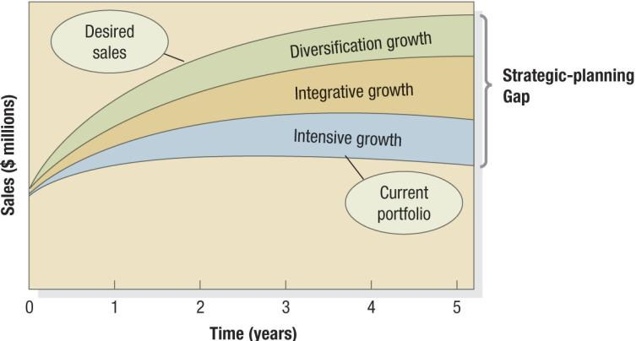
Corporate & Division Strategic Planning 4. Assessing Growth Opportunities
Strategic Planning Gap

Slide 10

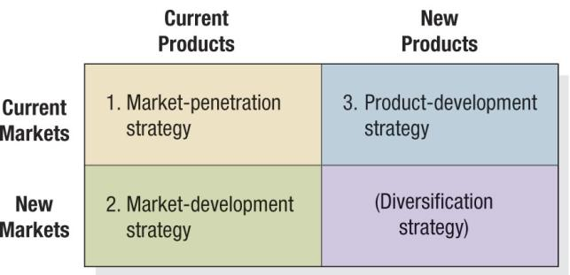
Corporate & Division Strategic Planning 4. Assessing Growth Opportunities
Intensive Growth
Ansoff Product-Market Expansion Grid

Slide 11
Corporate & Division Strategic Planning 4. Assessing Growth Opportunities
Integrative Growth
‘Integrations’
Backward: Acquire Suppliers
Forward: Acquire distributors/suppliers
Horizontal: Acquire Competitors

Slide 12
Corporate & Division Strategic Planning 4. Assessing Growth Opportunities
Diversification Growth
When good opportunities can be found outside current business
N.B. This relates to new line of business NOT products
Downsizing & Divesting
Pruning & harvesting current portfolio

Slide 13
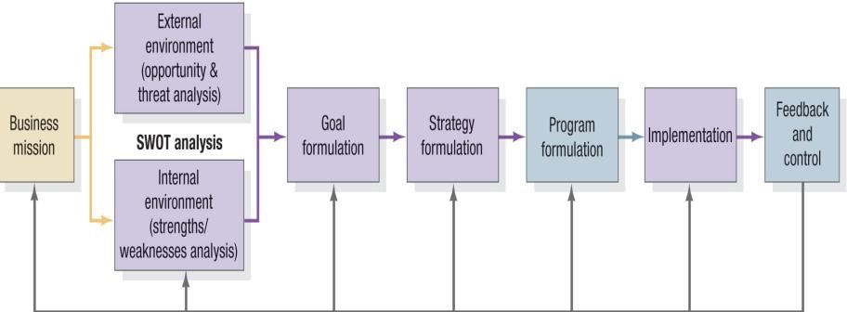
Business Unit Strategic Planning Process

Slide 14
Business Unit Strategic Planning SWOT Analysis
SWOT
Internal Environment Analysis
Strengths
Weaknesses
External Environment Analysis
Opportunities
Threats

Slide 15
Business Unit Strategic Planning Goal Formation
Setting objectives & MBO - Managing by Objectives
Goals should have these characteristics
They must be arranged hierarchically from the most to least important
Objectives should be stated quantitatively whenever possible
Goals should be realistic
Objectives must be consistent

Slide 16
Business Unit Strategic Planning Strategic Formulation
Goals: What a business wants to achieve
Strategy: A game plan for getting there
Examples of ‘Strategies’ >>
Porter’s Generic Strategies
Overall Cost Leadership
Differentiation
Focus
Strategic Alliances
Product or Service Alliances (licensing to produce its product)
Promotional Alliances (joint promotions)
Logistics Alliances
Pricing Collaborations (mutual price discounts)

Slide 17
Business Unit Strategic Planning Program Formulation & Implementation
Great Marketing Strategy can fail - If poorly implemented
Strategy is one the seven elements in business practice! (McKinsey) – other elements are important in implementation
Strategy, Structure and Systems- Hardware
Style, Skills, Staff, Shared values-Software
Strategy
Structure
Systems
Style
Skills
Staff
Shared Values

Slide 18
Business Unit Strategic Planning Feedback & Control
Need to track results and monitor new developments
Need to continuously examine changing environment and to adopt to new goals and behaviors

Slide 19
Product Planning: Marketing Plan
Marketing Plan
A written document that summarizes what the marketer has learned about the marketplace and indicates how the firm plans to reach its marketing objectives

Slide 20
Product Planning: Marketing Plan
Typical Contents of a MARKETING PLAN>>
Executive Summary & TOC
Situation Analysis
Marketing Strategy
Financial Projections
Implementation Controls
Very important: Self Read Exercise
Review marketing plan given in book

Slide 21
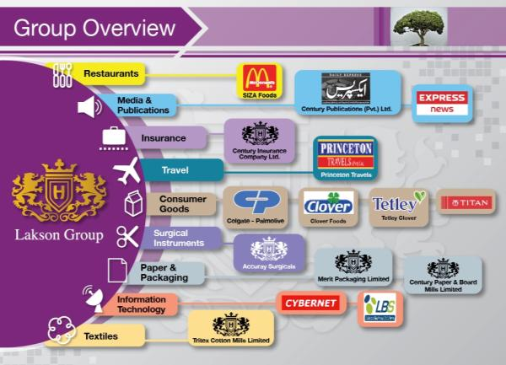
Marketing in Practice Part - 1
Lakson Group
Planning at different levels
Lakson Group - One of most prolific conglomerates
Planning horizons What kind of planning will be done at:
Corporate / Division level
Lakson group (The complete conglomerate)
Media division (one of the divisions )
Business Unit planning
Express News (an SBU within media division)
Product Planning
Launching a new “News show” (a “product” for the SBU)
OWN ACTIVITY: Visit www.lakson.com.pk
Learn about the complete group

